Slide 1
Simulating Roulette in R
By John Weng, Kathryn Flanagan, and Clay Moore
Notes:
John

Slide 2
Overview
Theory behind Player E
Code for Player E
Results
Conclusion
Notes:
Katie

Slide 3
Theory
Looked up popular Roulette strategies for betting on black or red
Found all Players modeled popular strategies
Player A – Flat Bet
Player B - Reverse Martingale
Player C – Martingale
Player D – Labouchere
All popular strategies. Let us emulate one of them!
"Red And Black Roulette Strategies." Roulette Strategy. Web. 26 Nov. 2015
Notes:
Clay

Slide 4
Player E – Fibonacci (Background)
Background – Fibonacci Sequence
Named after Italian mathematician Fibonacci
Used in data structures and search engine algorithms
Integer sequence of numbers
Denote a variable n, which is the count of how many numbers are in the sequence
Formula
Formula
Seed Values
"Fibonacci Sequence." Math Is Fun. Web. 28 Nov. 2015.
Notes:
Clay

Slide 5
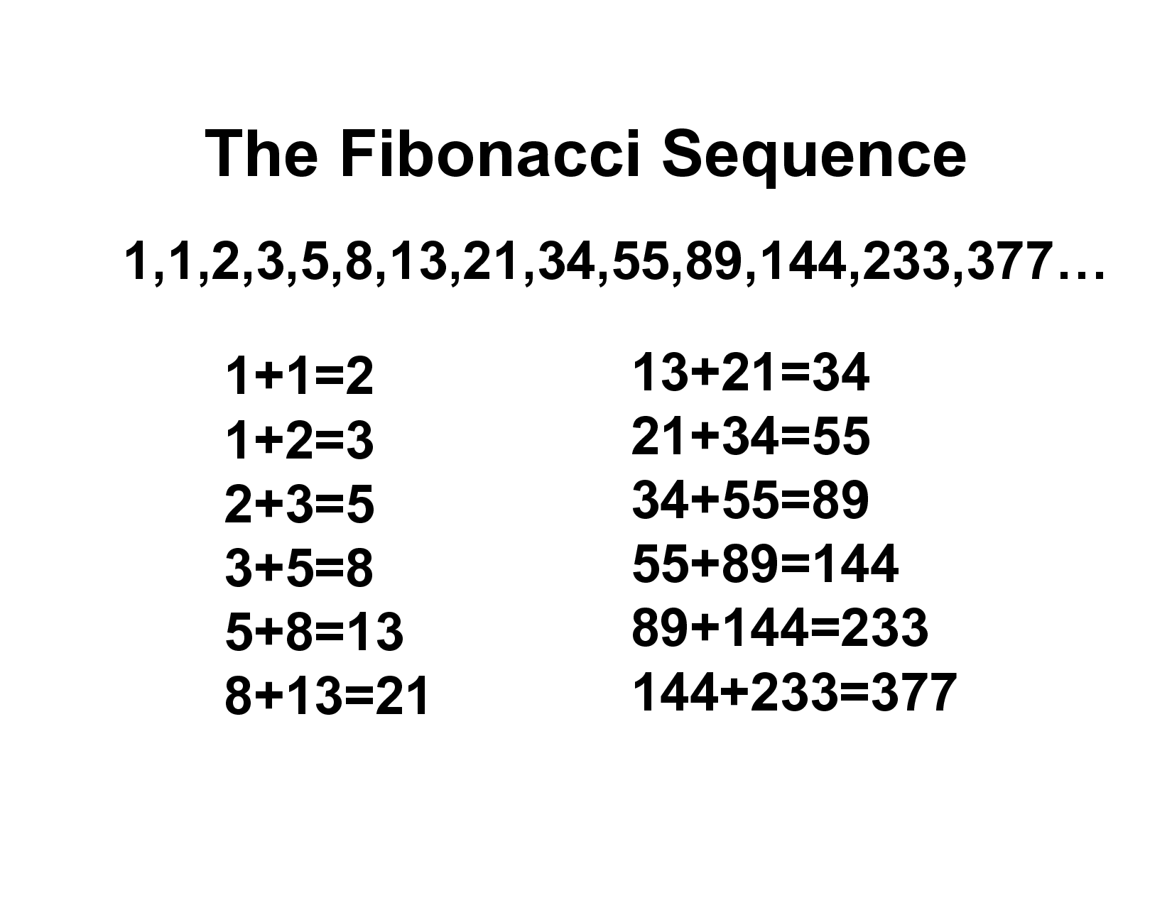

Slide 6
Player E – Fibonacci (Betting)
Start at n = 1 (F₁ = 1)
When you lose a bet
You increase n by 1
Progress further into the Fibonacci sequence
When you win a bet
You decrease n by 2
Decrease your bet
Lowest n = 1
Notes:
Clay

Slide 7
Player E – Fibonacci (Betting Example)
Start ($127)
Bet 1 and lose ($126)
Bet 1 and lose ($125)
Bet 2 and lose ($123)
Bet 3 and lose ($120)
Bet 5 and lose ($115)
Bet 8 and win ($123)
Bet 3 and win ($126)
Summary
Lose 5 times, lose 12 dollars
Win 2 times, win 11 dollars
Notes:
Clay

Slide 8
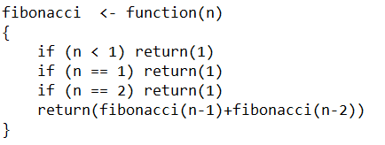
Player E – Fibonacci (Code)
Notes:
Clay

Slide 9
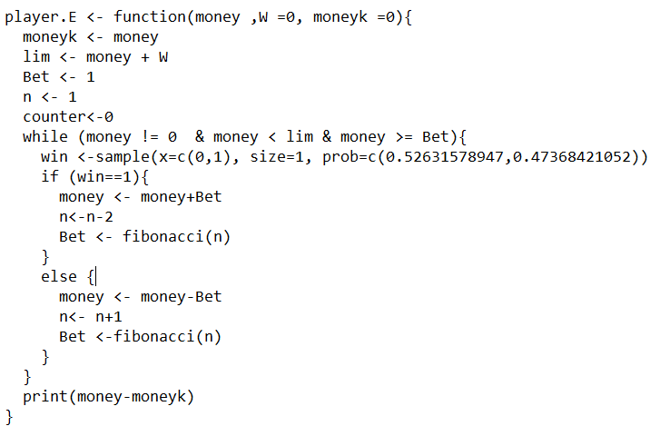
Player E – Example Code
Notes:
John

Slide 10
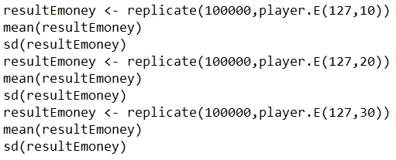
Player E – Replication Code
Notes:
John

Slide 11
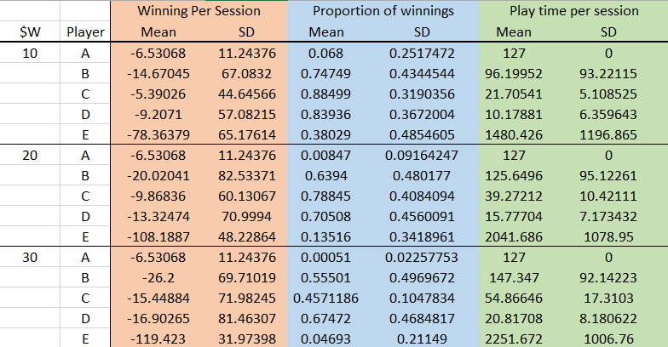
Full Results
Notes:
John

Slide 12
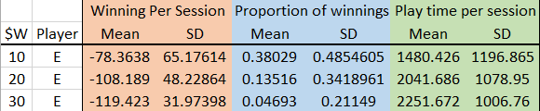
Player E - Results
Notes:
John

Slide 13
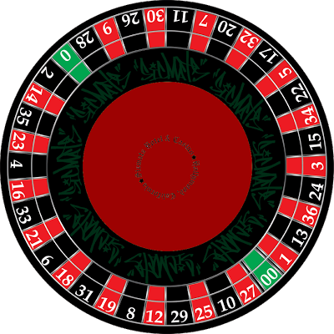
Player E – Results
Why was this a recommended strategy?
Works IF EVEN BETTING
P(win) = P(Lose)
In this project, not the case.
Notes:
Clay

Slide 14
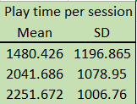
Player E - Pros
Play Time is huge, so get to play a lot per session
Say you used a Fibonnaci Sequence to bet in Roulette
Notes:
Katie

Slide 15
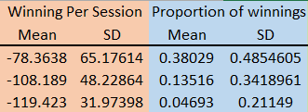
Player E - Cons
Don’t win a lot
Winnings
Proportions
Notes:
Katie

Slide 16
Player E - Conclusion
If you want to procrastinate and not do anything for a long time EXCEPT lose money, use the Fibonnaci betting method
If you want to keep your money, not waste your time, and want to win, DO NOT use the Fibonnaci betting method
Notes:
Katie

Slide 17
Questions?

